Slide 1
Module 5:
Describe identity, governance, privacy, and compliance features (15- 20%)

Slide 2









About The Presenter
Muhammad Gouda
Senior Consultant at Microsoft. Almost 20 years of experience
Certified Azure Developer
Hold DevOps Dojo White Belt from Microsoft
Certified Scrum Master
Certified Problem Solver from HackerRank
in/muhammadgouda/
Certified ITIL Foundation

Slide 3


Remember
Azure AD
Authentication
Authorization
MFA
SSO
Azure AD Connect
Conditional Access
RBAC
Locks
Tags
Azure Policy
Initiatives
Azure Blueprints
Azure Government
Azure China 21Vianet
Notes:
How Cloud Can Help DevOps Transformation

Slide 4

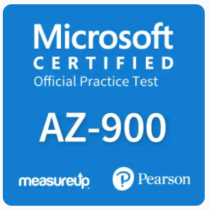
References
Microsoft Learn
MeasureUp Practice Test
Notes:
How Cloud Can Help DevOps Transformation

Slide 5
Module 5:
Question
#1

Slide 6
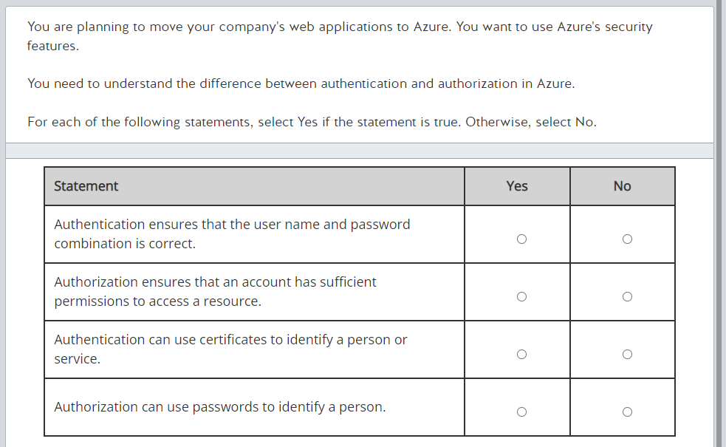
Question #1

Slide 7
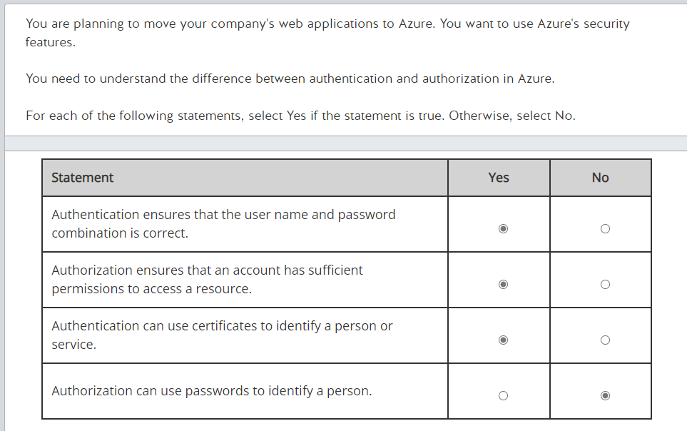
Answer #1

Slide 8
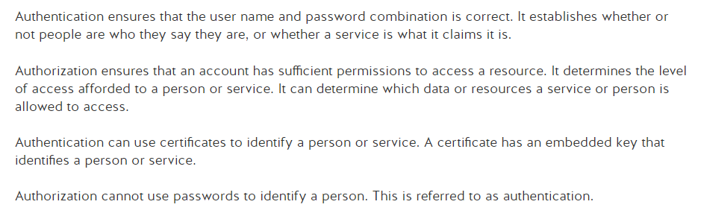
Explanation #1

Slide 9
Module 5:
Question
#2

Slide 10
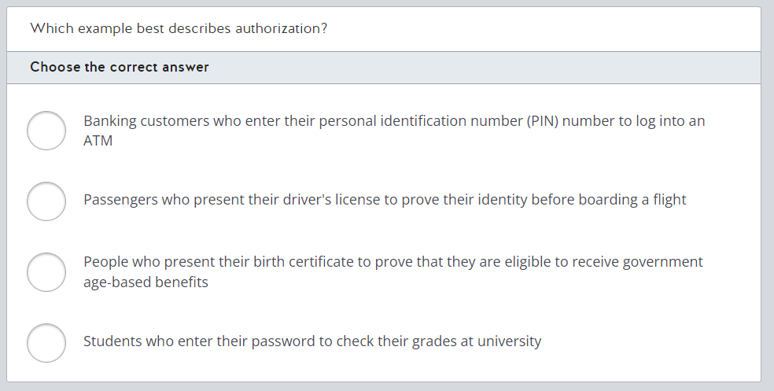
Question #2

Slide 11
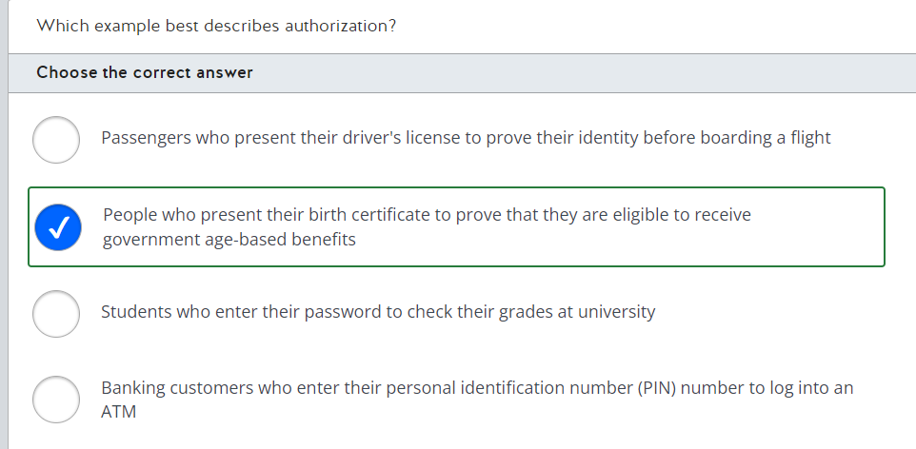
Answer #2

Slide 12
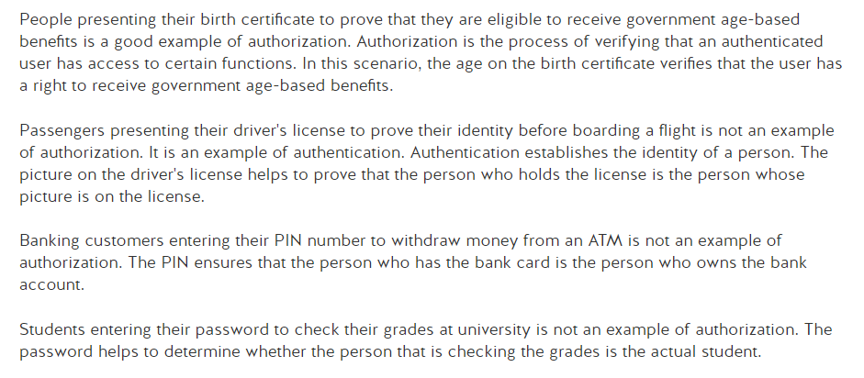
Explanation #2

Slide 13
Module 5:
Question
#3

Slide 14
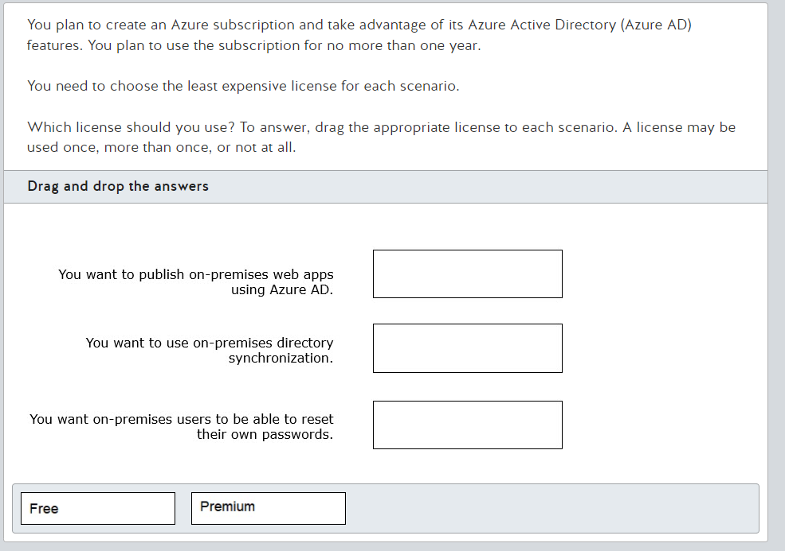
Question #3

Slide 15
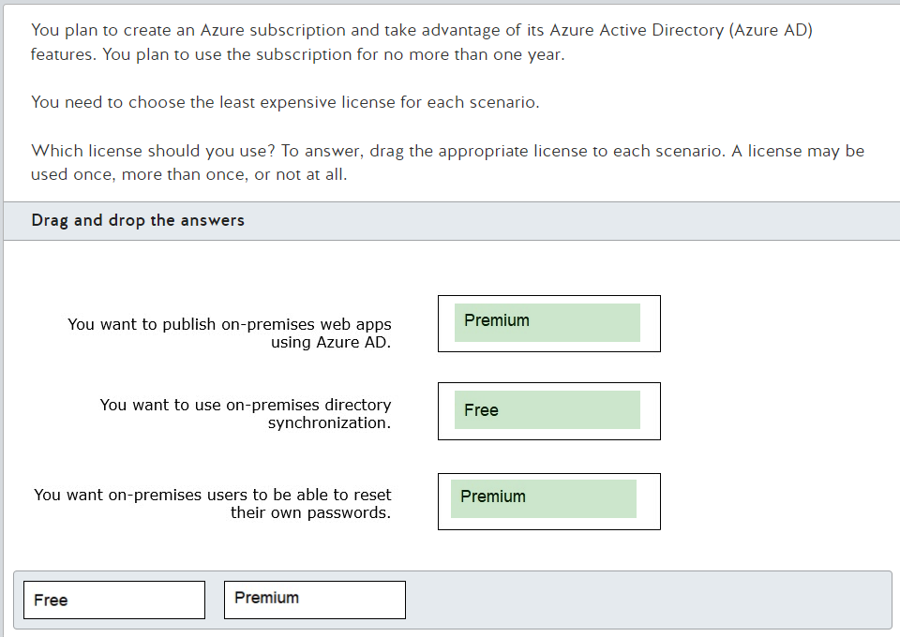
Answer #3

Slide 16
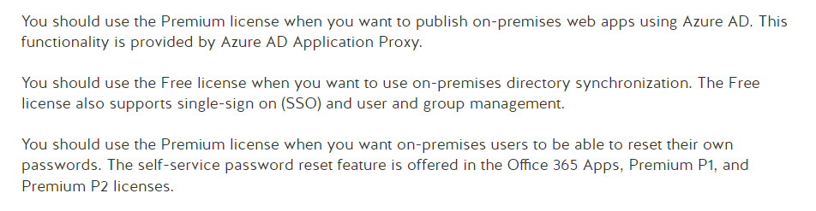
Explanation #3

Slide 17
Module 5:
Question
#4

Slide 18
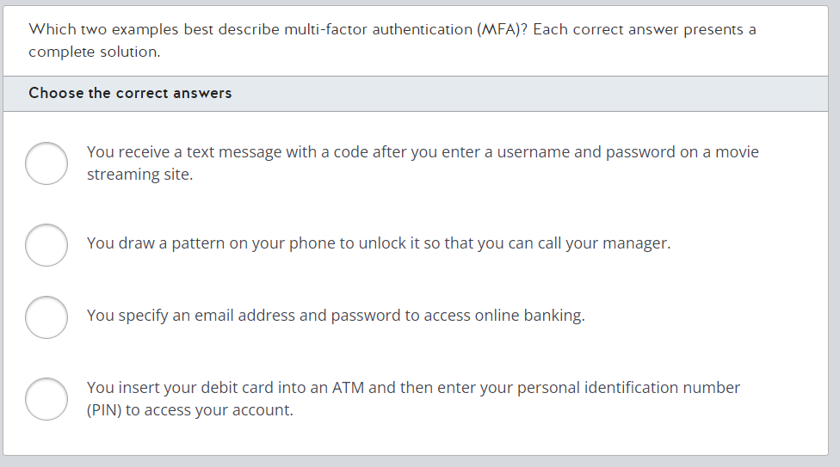
Question #4

Slide 19
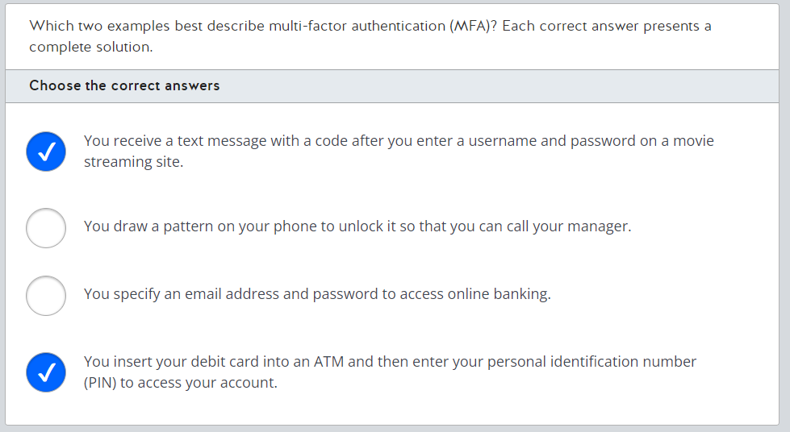
Answer #4

Slide 20
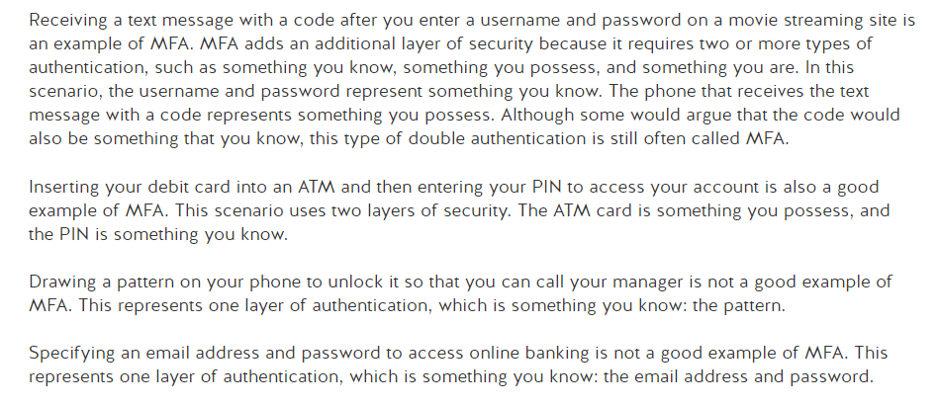
Explanation #4

Slide 21
Module 5:
Question
#5

Slide 22
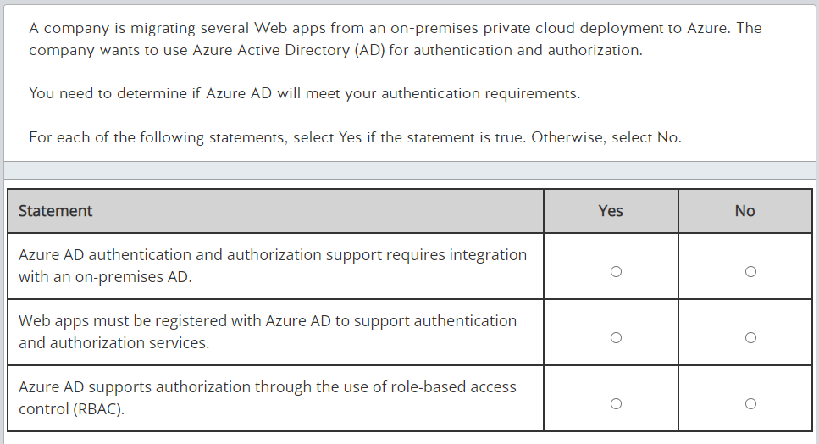
Question #5

Slide 23
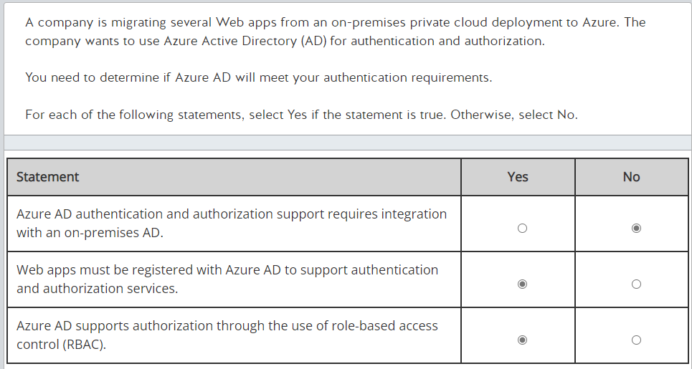
Answer #5

Slide 24
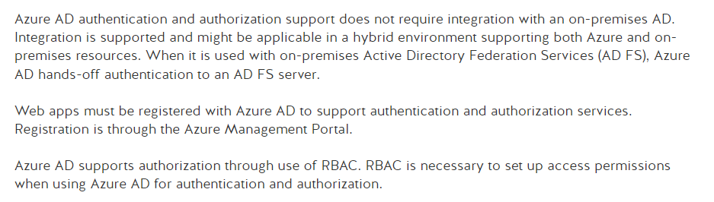
Explanation #5

Slide 25
Module 5:
Question
#6

Slide 26
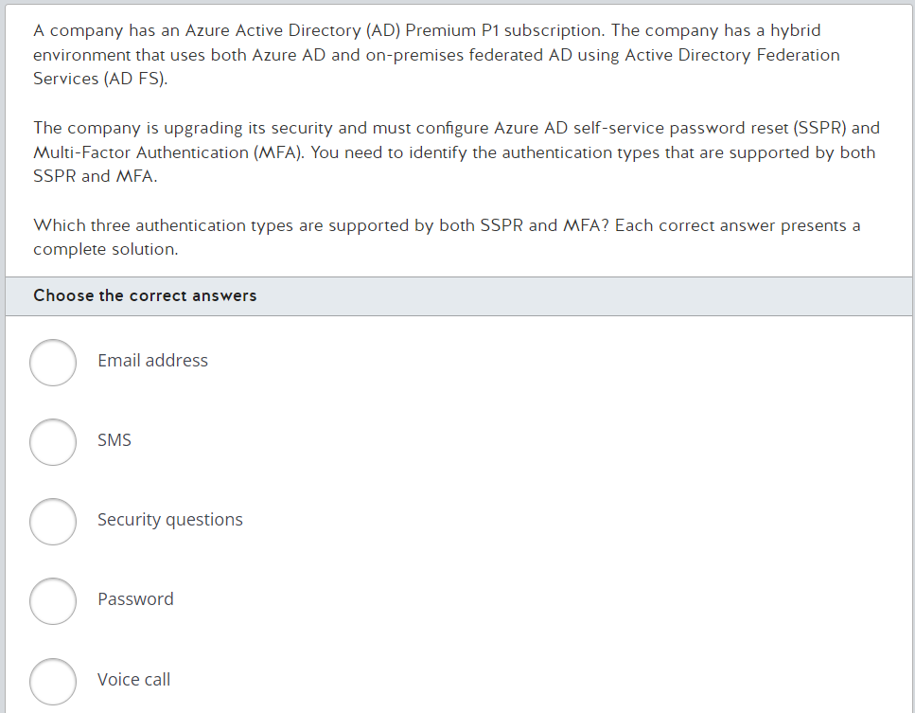
Question #6

Slide 27
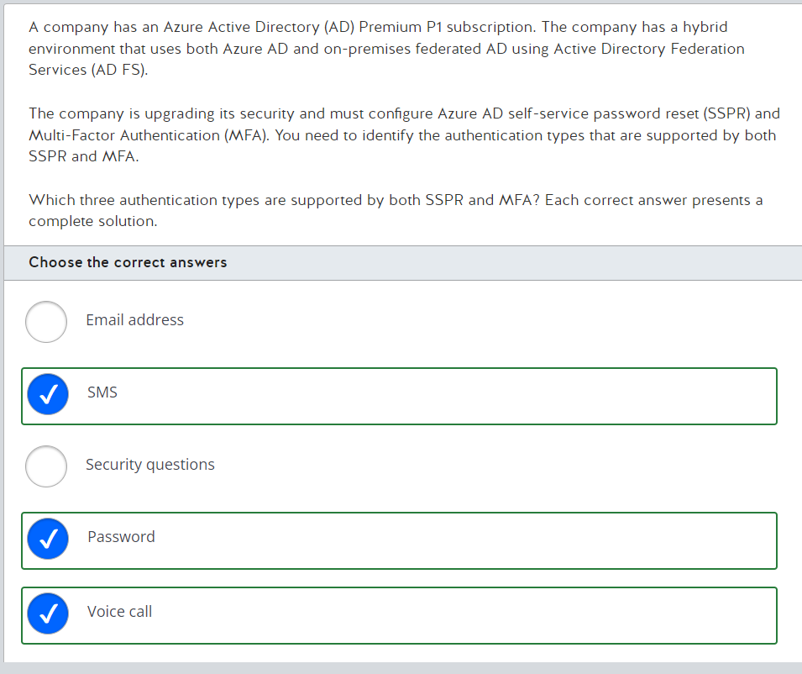
Answer #6

Slide 28
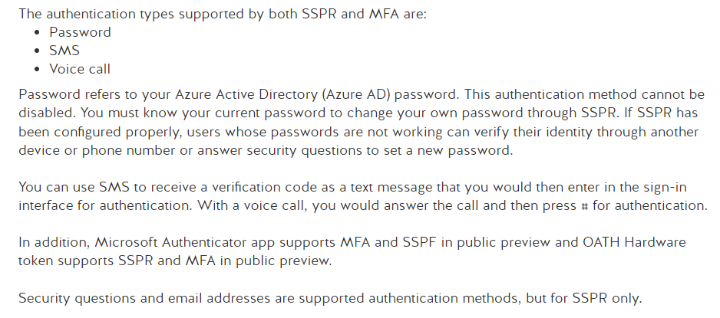
Explanation #6

Slide 29
Module 5:
Question
#7

Slide 30
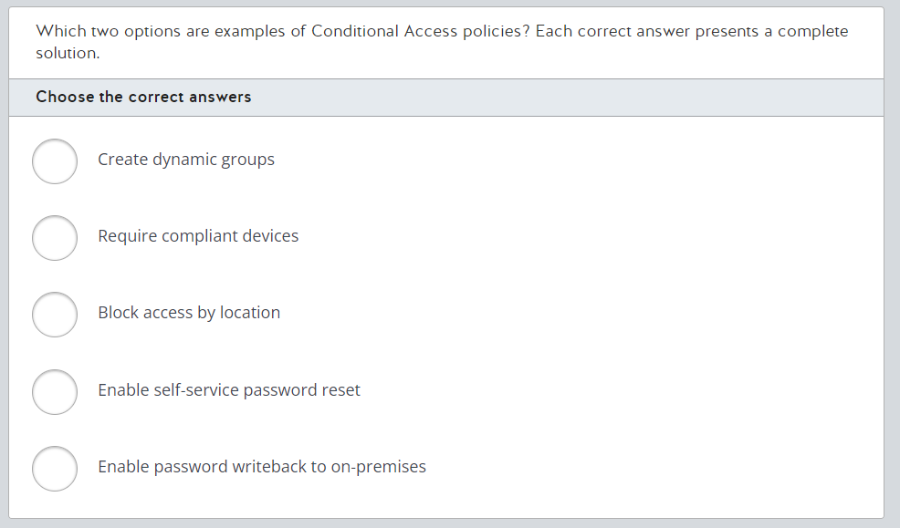
Question #7

Slide 31
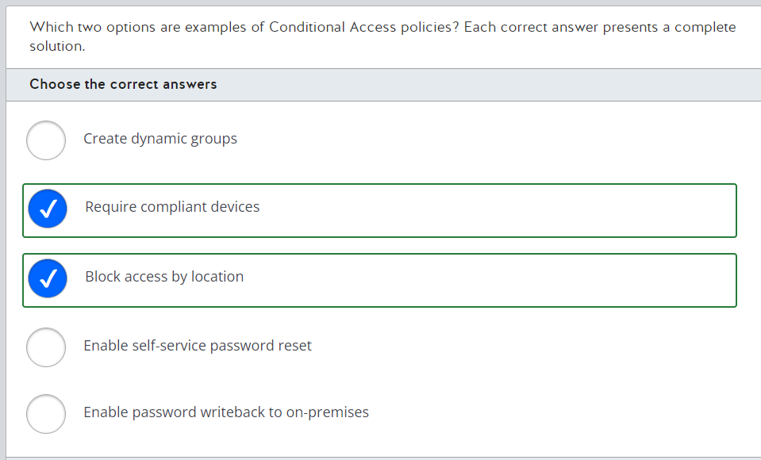
Answer #7

Slide 32
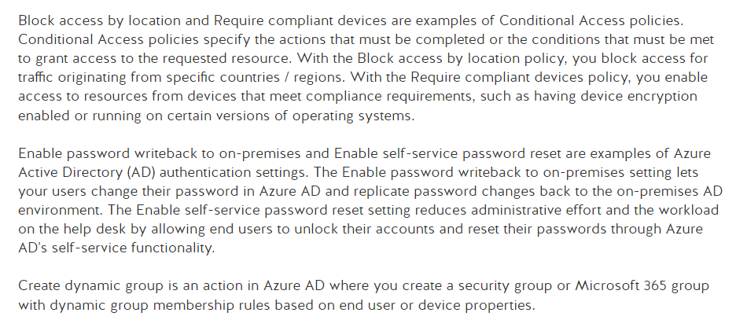
Explanation #7

Slide 33
Module 5:
Question
#8

Slide 34
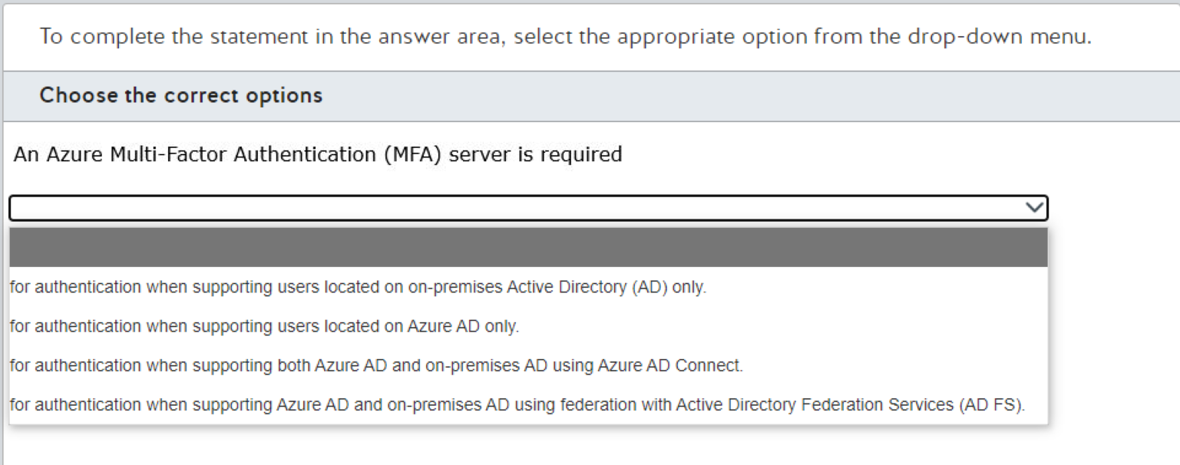
Question #8

Slide 35
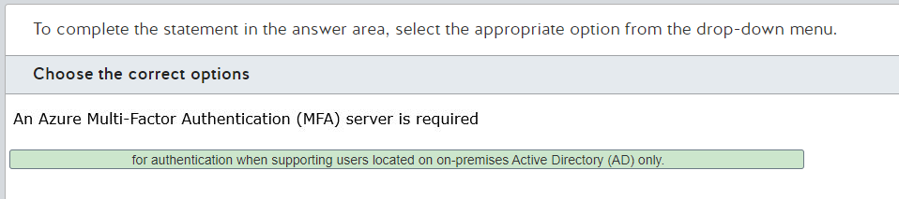
Answer #8

Slide 36
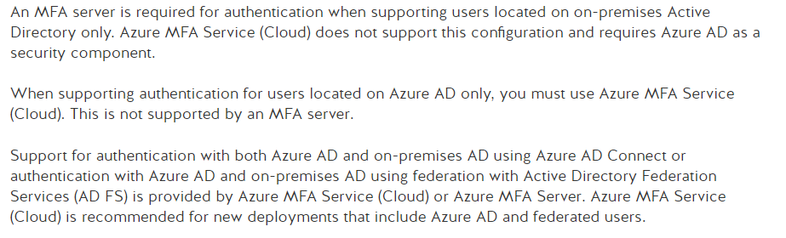
Explanation #8

Slide 37
Module 5:
Question
#9

Slide 38
Question #9
How can the IT department ensure that employees at the company's retail stores can access company applications only from approved tablet devices?
Choose the correct answer
○ SSO
○ MFA
○ Conditional Access
○ Azure AD Connect

Slide 39

Answer #9
How can the IT department ensure that employees at the company's retail stores can access company applications only from approved tablet devices?
Choose the correct answer
○ SSO
○ MFA
○ Conditional Access
○ Azure AD Connect

Slide 40
Explanation #9
SSO stands for Single Sign-On which is enables users to sign into different service with the same credentials
MFA stands for Multi-Factor Authentication which is a process where a user is prompted during the sign-in process for an additional form of identification (e.g., include a code on their cell phone or a fingerprint scan)
Conditional Access is a tool that Azure Active Directory uses to allow (or deny) access to resources based on identity signals. These signals include who the user is, where the user is, and what device the user is requesting access from.
Azure AD Connect is a tool to connect on-premise Active Directory installation with Azure AD

Slide 41
Module 5:
Question
#10

Slide 42
Question #10
If you have a resource group that is locked for deletion, and you have created a VM inside that resource group. What are the prerequisite for deleting that VM
Choose the correct answer
○ You must unlock the VM only
○ You must unlock the Resource Group only
○ You must unlock both the Resource Group and the VM
○ You can delete the VM with no prerequisites

Slide 43
Answer #10
If you have a resource group that is locked for deletion, and you have created a VM inside that resource group. What are the prerequisite for deleting that VM
Choose the correct answer
○ You must unlock the VM only
○ You must unlock the Resource Group only
○ You must unlock both the Resource Group and the VM
○ You can delete the VM with no prerequisites

Slide 44
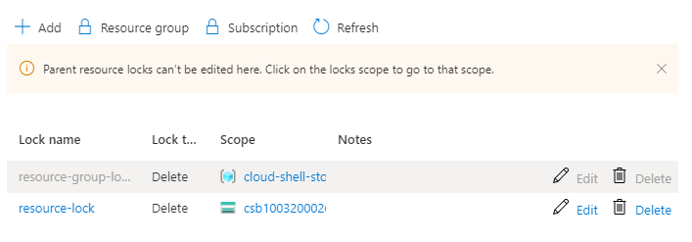
Explanation #10
As you didn’t lock the VM, you don’t need to unlock it, neither you can do so. It was locked only because its resource group is locked
Once you unlock the resource group, all its resources will be automatically unlocked unless there is a resource that is locked explicitly

Slide 45
Module 5:
Question
#11

Slide 46
Question #11
Your organization has 2 environments (one for Development and another for Testing), and they want to allow some users to control the virtual machines in each environment but prevent them from modifying networking and other resources in the same resource group or Azure subscription? What is the best approach to achieve this?
Choose the correct answer
○ Create a role assignment through Azure RBAC
○ Create a policy in Azure Policy that audits resource usage
○ Split the environment into separate resource groups

Slide 47
Answer #11
Your organization has 2 environments (one for Development and another for Testing) under the same subscription, and they want to allow some users to control the virtual machines in each environment but prevent them from modifying networking and other resources in the same resource group or Azure subscription? What is the best approach to achieve this?
Choose the correct answer
○ Create a role assignment through Azure RBAC
○ Create a policy in Azure Policy that audits resource usage
○ Split the environment into separate resource groups

Slide 48
Explanation #11
RBAC stands for Role Based Access Control, where you assign a specific set of roles to each user to define which resources they can access and what actions they can do on those resources True
Azure Policy is an Azure service that enables you to enforce some rules on who your Azure resources are created, but it does not control which user creates or modifies those resources
Although splitting the 2 environments into 2 resource groups is a good practice, it does not control access to those groups. Besides, the level of control in the question is required on specific resource types inside the same group (i.e., the same user should be able to control VMs in both environments modifying network resources)

Slide 49
Module 5:
Question
#12

Slide 50
Question #12
Azure Government is a special package of Azure services that serves any government entity around the world
Choose the correct answer
○ True
○ False

Slide 51
Answer #12
Azure Government is a special package of Azure services that serves any government entity around the world
Choose the correct answer
○ True
○ False

Slide 52
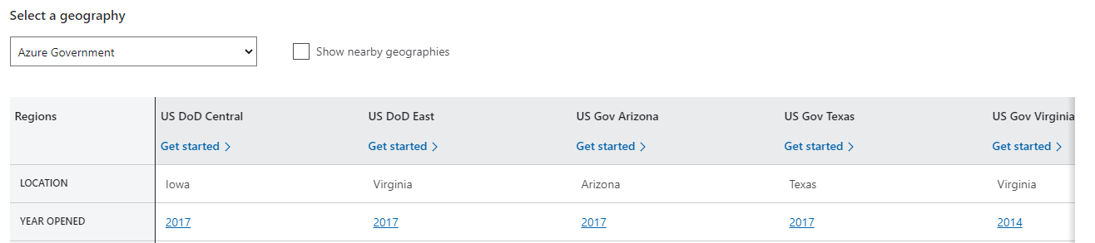
Explanation #12
Azure Government is a separate instance of the Microsoft Azure service. It addresses the security and compliance needs of United States federal agencies, state and local governments, and their solution providers. It offers physical isolation from non-US government deployments and provides screened US personnel True

Slide 53
Best Wishes

